Slide 1
Technology in Biology
Created by: Ashley Vital

Slide 2
Table of Contents
Introduction
Virus Detection
Microscopy and Imagery
Treatment
Video
Ecological Purposes
AI Purposes
Collaboration
Works Cited

Slide 3


Introduction
What is Biology?
Biology is defined as the study of living organisms, their origins, anatomy, morphology, physiology, behavior, and distribution.
How can technology relate to it?
Technology helps advance the study of life by using devices and research.

Slide 4
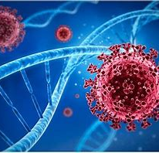
Virus Detection
Technology can help detect viruses by using Computers. Computers can help alert scientists about potential outbreaks that can help them start to prepare themselves for what can occur.
Without computers it would take a bit longer to see the outbreak affecting humans and to seek help from them.

Slide 5


Microscopy and Imagery
Computers play a vital role in modeling because it gives you a third eye to see things from a different perspective. The modeling program can help come with logical questions that could occur in real life which helps us test it, to prepare for a real-life situation.
Imagery is just as equally important because it helps show the structure and lifecycle of viruses.

Slide 6
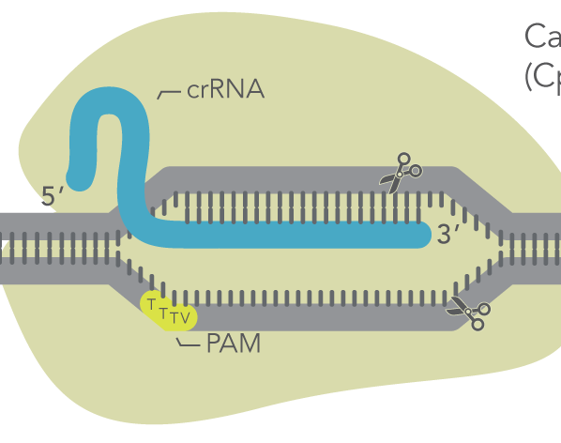
Treatment
There is a tool, called CRISPR-Cas12a, It can help researchers simultaneously assess the impact of multiple genetic changes involved in variety of immunes system responses.
Example would be Ebola.. To find the optimal locations for six Ebola treatment centers, Telionis's computer model sought to minimize the distance an infected person anywhere in the six-county area would have to travel for treatment.

Slide 7

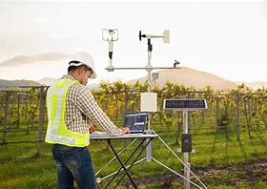
Ecological Purposes
Monitoring ecosystems can provide a non-intrusive means of monitoring species behavior, distribution and diversity within a landscape, and help protect threatened wildlife and habitats
Biotechnology is useful because it finds a way to break down the pollutants. Bioremediation is the use of microorganism, such as bacteria, fungi, and algae, to remove pollutants from the environment.
Pollution may never disappear, but we can manage it with these tools.

Slide 8
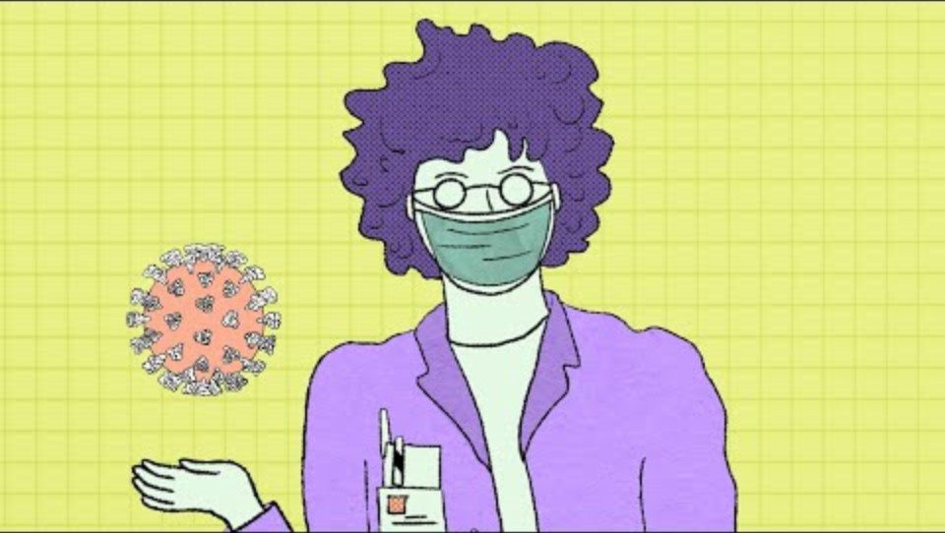

Video
Start at
3:50:00

Slide 9
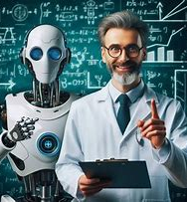
AI Purposes
AI is useful in the lab because without a doubt it I did not exist it would take a lot longer to find and do research.
AI also helps create an image it truly shows what can occur to and the results after a sickness, disease or mutation occurs.
Al can also help read X-rays, MRI, and CT scans. Which is good because it's like having a second opinion.

Slide 10

Collaboration
Technology allows one to collaborate with another and produce how to continue to better help the environment. Sources such as Google Drive, Zoom, or even Microsoft Teams.
People can use those tools to talk to people from all around the country. They can also use platforms like Facebook, Instagram, WhatsApp and more. This is a great tool because then scientists can brainstorm with each other and basically bounce off ideas to come up with the best solution.

Slide 11
Works Cited
Brown, David. “How Computer Modelers Took on the Ebola Outbreak.” IEEE Spectrum, IEEE Spectrum, 9 Feb. 2023, spectrum.ieee.org/how-computer-modelers-took-on-the-ebola-outbreak.
Goldsmith, Cynthia S, and Sara E Miller. “Modern Uses of Electron Microscopy for Detection of Viruses.” Clinical Microbiology Reviews, U.S. National Library of Medicine, Oct. 2009, pmc.ncbi.nlm.nih.gov/articles/PMC2772359/.
Hathaway, Bill. “NEW CRISPR Tool Enables More Seamless Gene Editing - and Improved Disease Modeling.” Yale News, 20 Mar. 2025, news.yale.edu/2025/03/20/new-crispr-tool-enables-more-seamless-gene-editing-and-improved-disease-modeling.
“Role of Biotechnology in Pollution Control.” Tutorialspoint, www.tutorialspoint.com/role-of-biotechnology-in-pollution-control. Accessed 1 Apr. 2025.
Team, BiologyInsights, and Published Dec 2. “Understanding Viral Infection: Structure, Entry, and Spread.” BiologyInsights, 2 Dec. 2024, biologyinsights.com/understanding-viral-infection-structure-entry-and-spread/.

